Slide 1

The Menstrual Cycle

Slide 2
The Menstrual Cycle

Slide 3
What is the menstrual cycle?
The process in which females ripen or release one mature egg.
The average menstrual cycle will repeat itself about every 28 days, but normal menstrual cycles can range from 21 to 40 days.

Slide 4
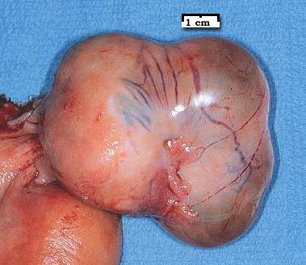
Changes in Pituitary Hormones Days 1-14:
During the first half of the cycle (Days 1-14) the pituitary produces FSH, which stimulates egg production.
This hormone also triggers the release of estrogen from the ovaries.

Slide 5
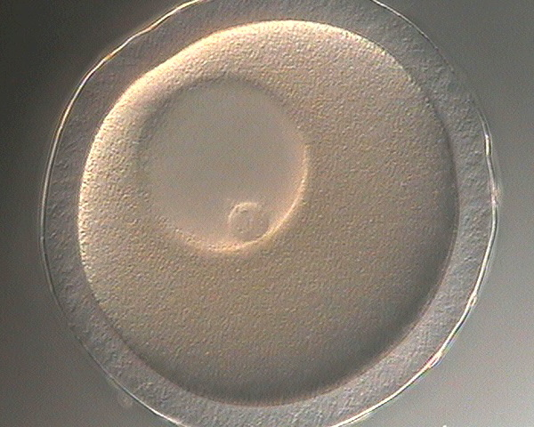
Changes in Pituitary Hormones Days 14-28:
On the 14th day the pituitary begins releasing LH causing ovulation
LH also directs the production of progesterone which maintains the growth of the endometrium.
If the egg is not fertilized upon arrival in the uterus progesterone levels drop causing estrogen levels to drop leading to menstruation.

Slide 6
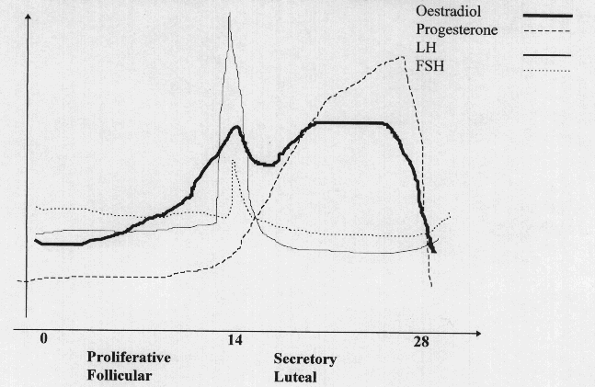
Pituitary Hormones

Slide 7
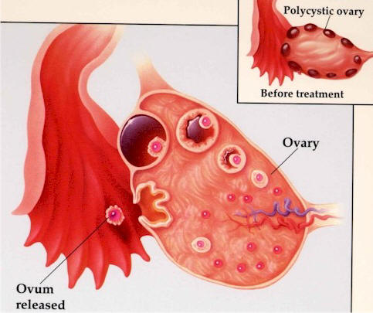
Changes in the Ovaries:
Stage 3 - Ovulation fully mature egg bursts out of follicle.
Stage 2 - egg continues to ripen; follicle growth.
Stage 1 - ovum begins to develop.
Stage 4 - Egg enters fallopian tube follicle remains and forms the corpus luteum.

Slide 8
Changes in the Ovaries:
Stage 1 - An egg is beginning to mature within a cluster of cells called a follicle
Stage 2 - Rapid follicle and egg growth
Stage 3 - Ovulation occurs; fully mature egg bursts out of the follicle (fertile) empty follicle transforms into the corpus luteum
Stage 4 - Egg travels through fallopian tube (7 days) if not fertilized upon arrival in uterus the corpus luteum shrinks triggering menstruation and ripening of new egg.

Slide 9
Changes in Ovarian Hormones:
Estrogen -gradually increases during days 1-14; signals body to thicken the lining of the uterus. Levels drop sharply after ovulation.
Progesterone -Levels remain low during the first half of the cycle and then increase sharplyduring the second half of the cycle. Maintaining the growth of the endometrium lining.

Slide 10
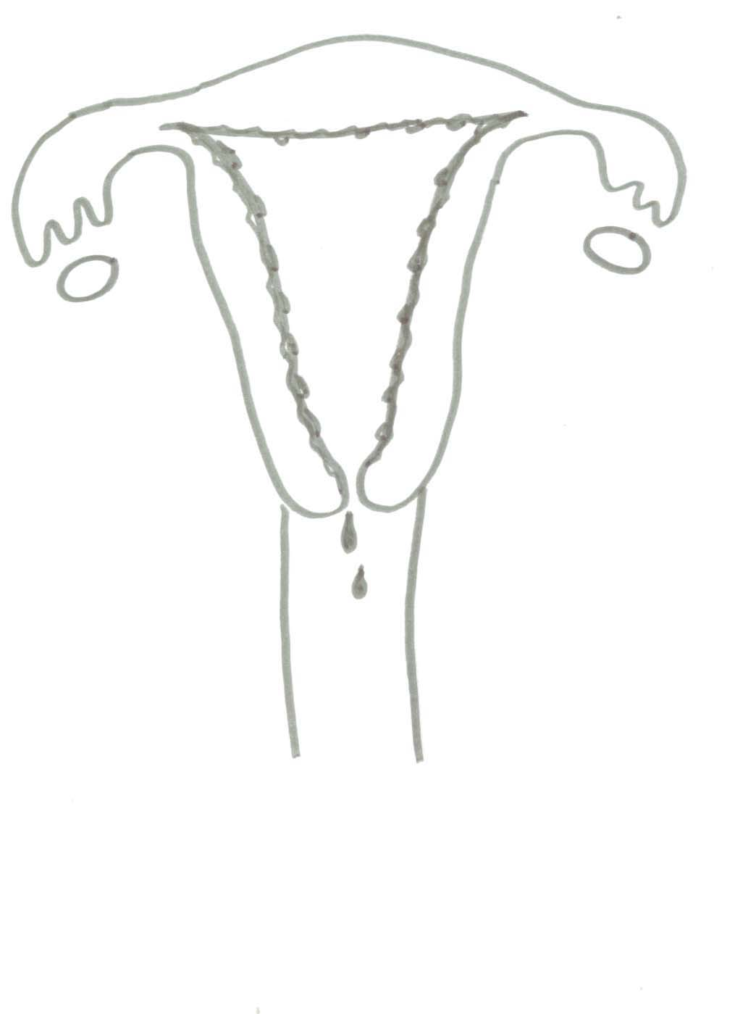
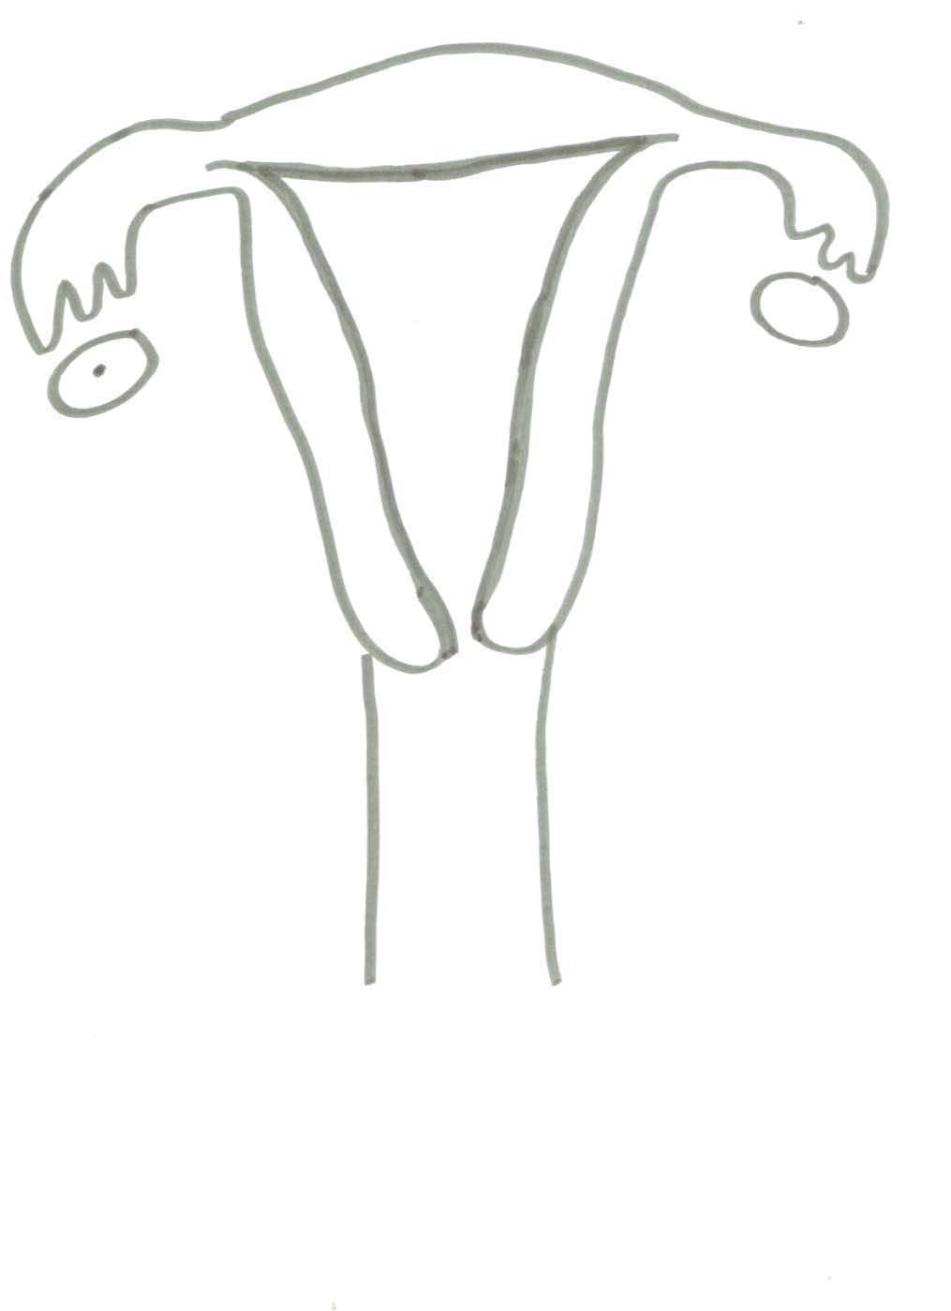
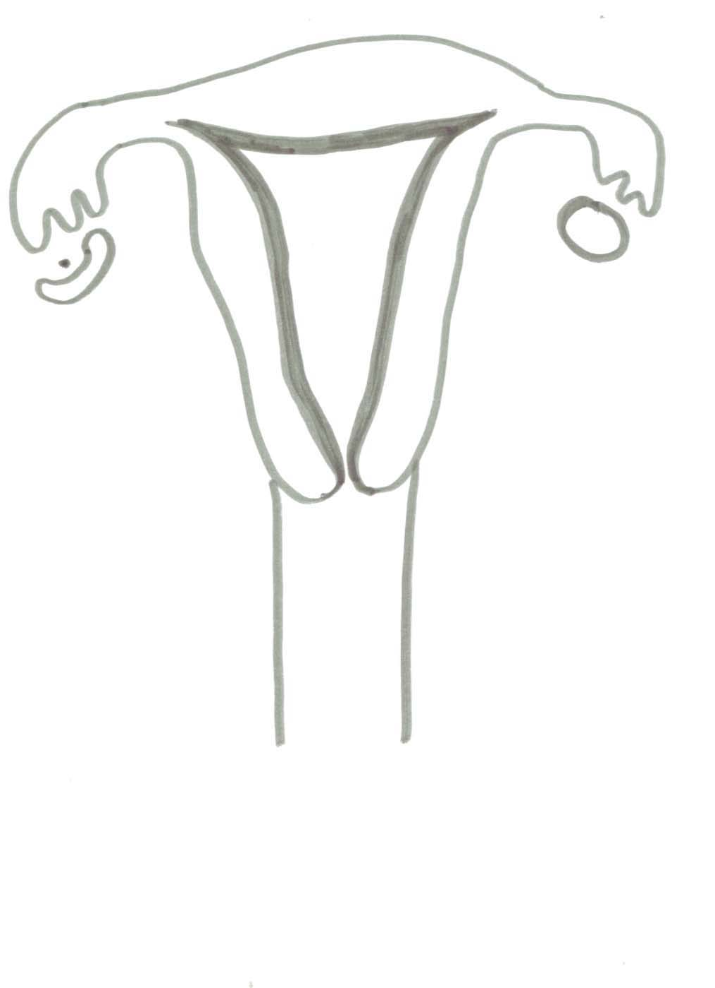
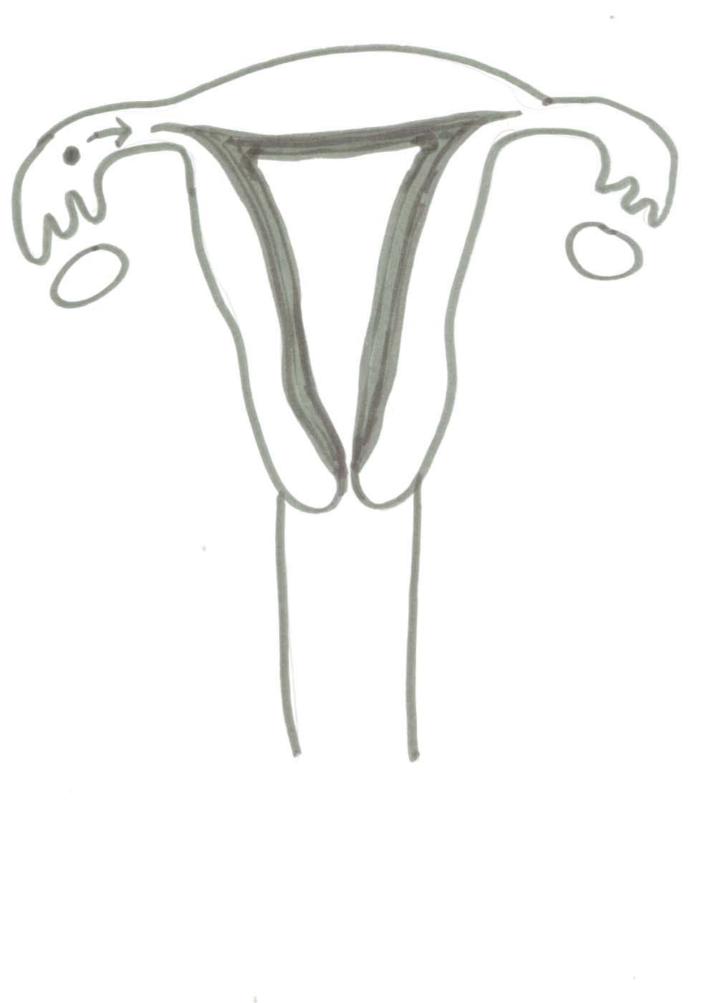
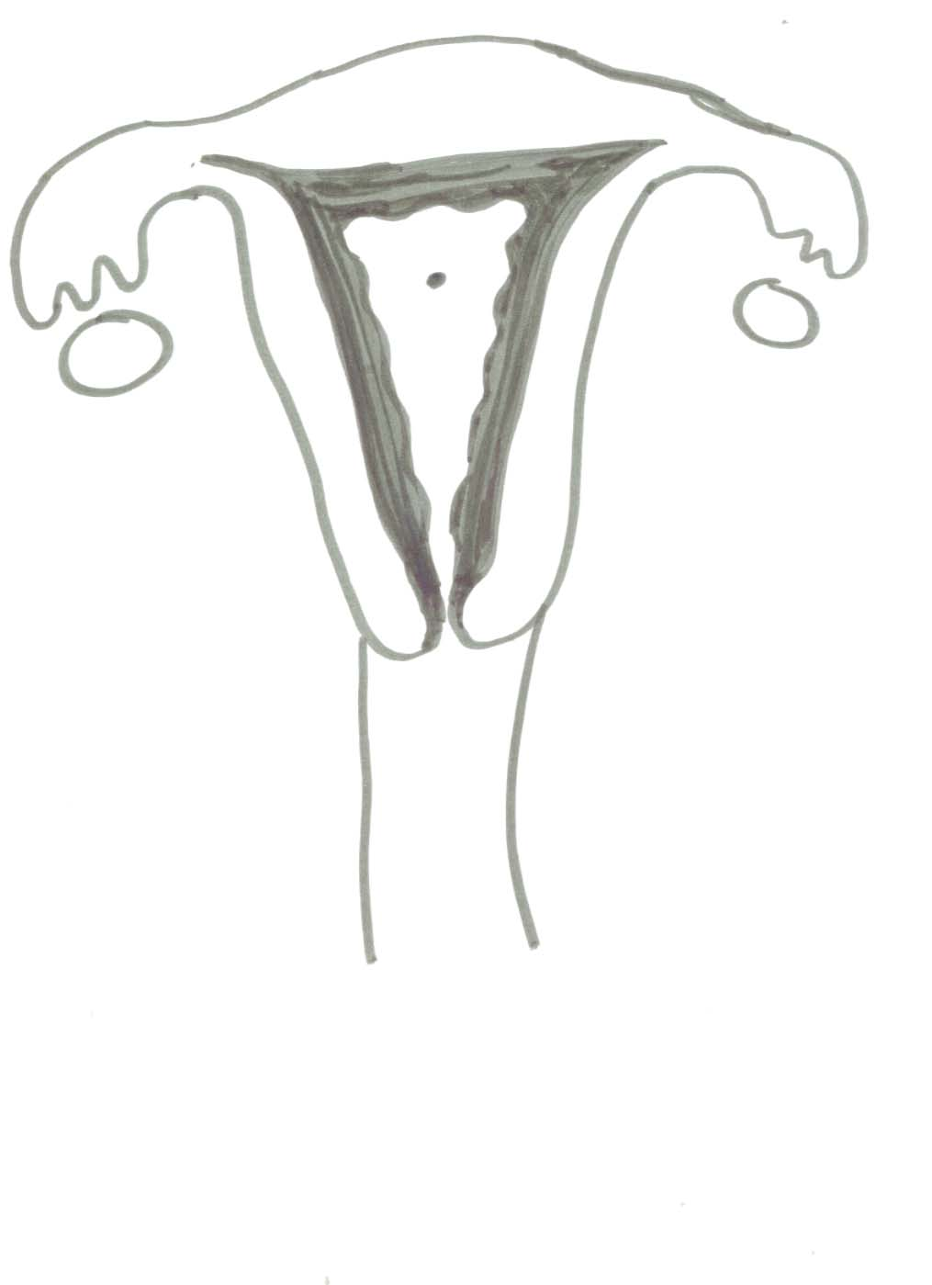
Changes in the Uterus:
Stage 2 Day 5- 13 pre-ovulatory stage
Stage 1- Day 1-5 menstruation
Stage 3 Day 14 Ovulation
Stage 4 Day 15-28 post-ovulatory stage

Slide 11
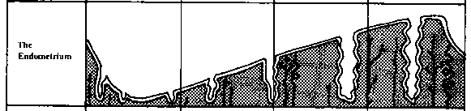
The uterine lining slowly thickens from day 5 through day 28

Slide 12
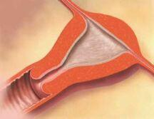
Changes in the Uterus:
Stage 1- Menstruation- Endometrium breaks down and blood, mucus, tissue, and the egg are shed through the vagina.
Stage 2- Menstrual flow stops & endometrium begins to thicken.
Stage 3- Endometrium continues to thicken.
Stage 4- The endometrium is at it’s thickest point.

Slide 13
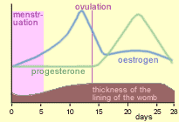
Ovarian Hormones

Slide 14
Days 1-14

Slide 15
Days 14 - 28

Slide 16
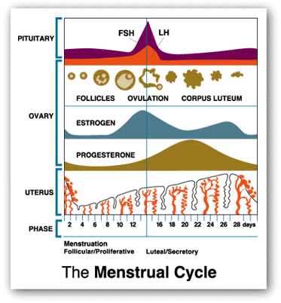

Slide 17
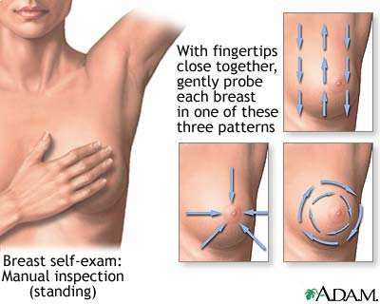
Breast Self Exams
Monthly check to detect changes that could lead to breast cancer.
Step One – “Look” In a mirror look for dimples, puckering,redness of the breast skin, discharge from the nipples, or change in breast size or shape.
Step two – With flat fingers feel from top to bottom or in circles making sure to examine the entire breast.

Slide 18
Common Complications of the Female Reproductive System
Ovarian Cysts- Fluid filled sacs on the surface of an ovary usually harmless; sometimes more serious. Symptoms include sudden severe abdominal pain, fever, vomiting.
Pelvic Inflammatory Disease- Infection leading to damage of the reproductive organs. If untreated may lead to chronic pain, infertility, and ectopic pregnancy
Breast Cancer- uncontrolled cell growth that invades surrounding tissue and destroys it.

